Slide 1
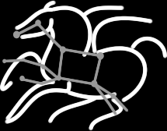
Pegasus - Helping the Work Flow for Users
Karan Vahi
Science Automation Technologies Group
USC Information Sciences Institute

Slide 2

Connecting Pipelines
Problem
For large scale analysis, scientists often want to compose larger constructs from smaller working pipelines.
Groups from the same domain collaborate and want to connect pipelines as part of larger analysis
Also want to scale to workflows with millions of tasks in total.
Example Application Use Case - Montage Galactic Plane Workflow
Existing montage workflow that can generate 5 degree mosiacs
18 million input images (~2.5 TB)
900 output images (2.5 GB each, 2.4 TB total)
10.5 million tasks (34,000 CPU hours)
× 17
Notes:
Kent changed 080501 – removed period

Slide 3
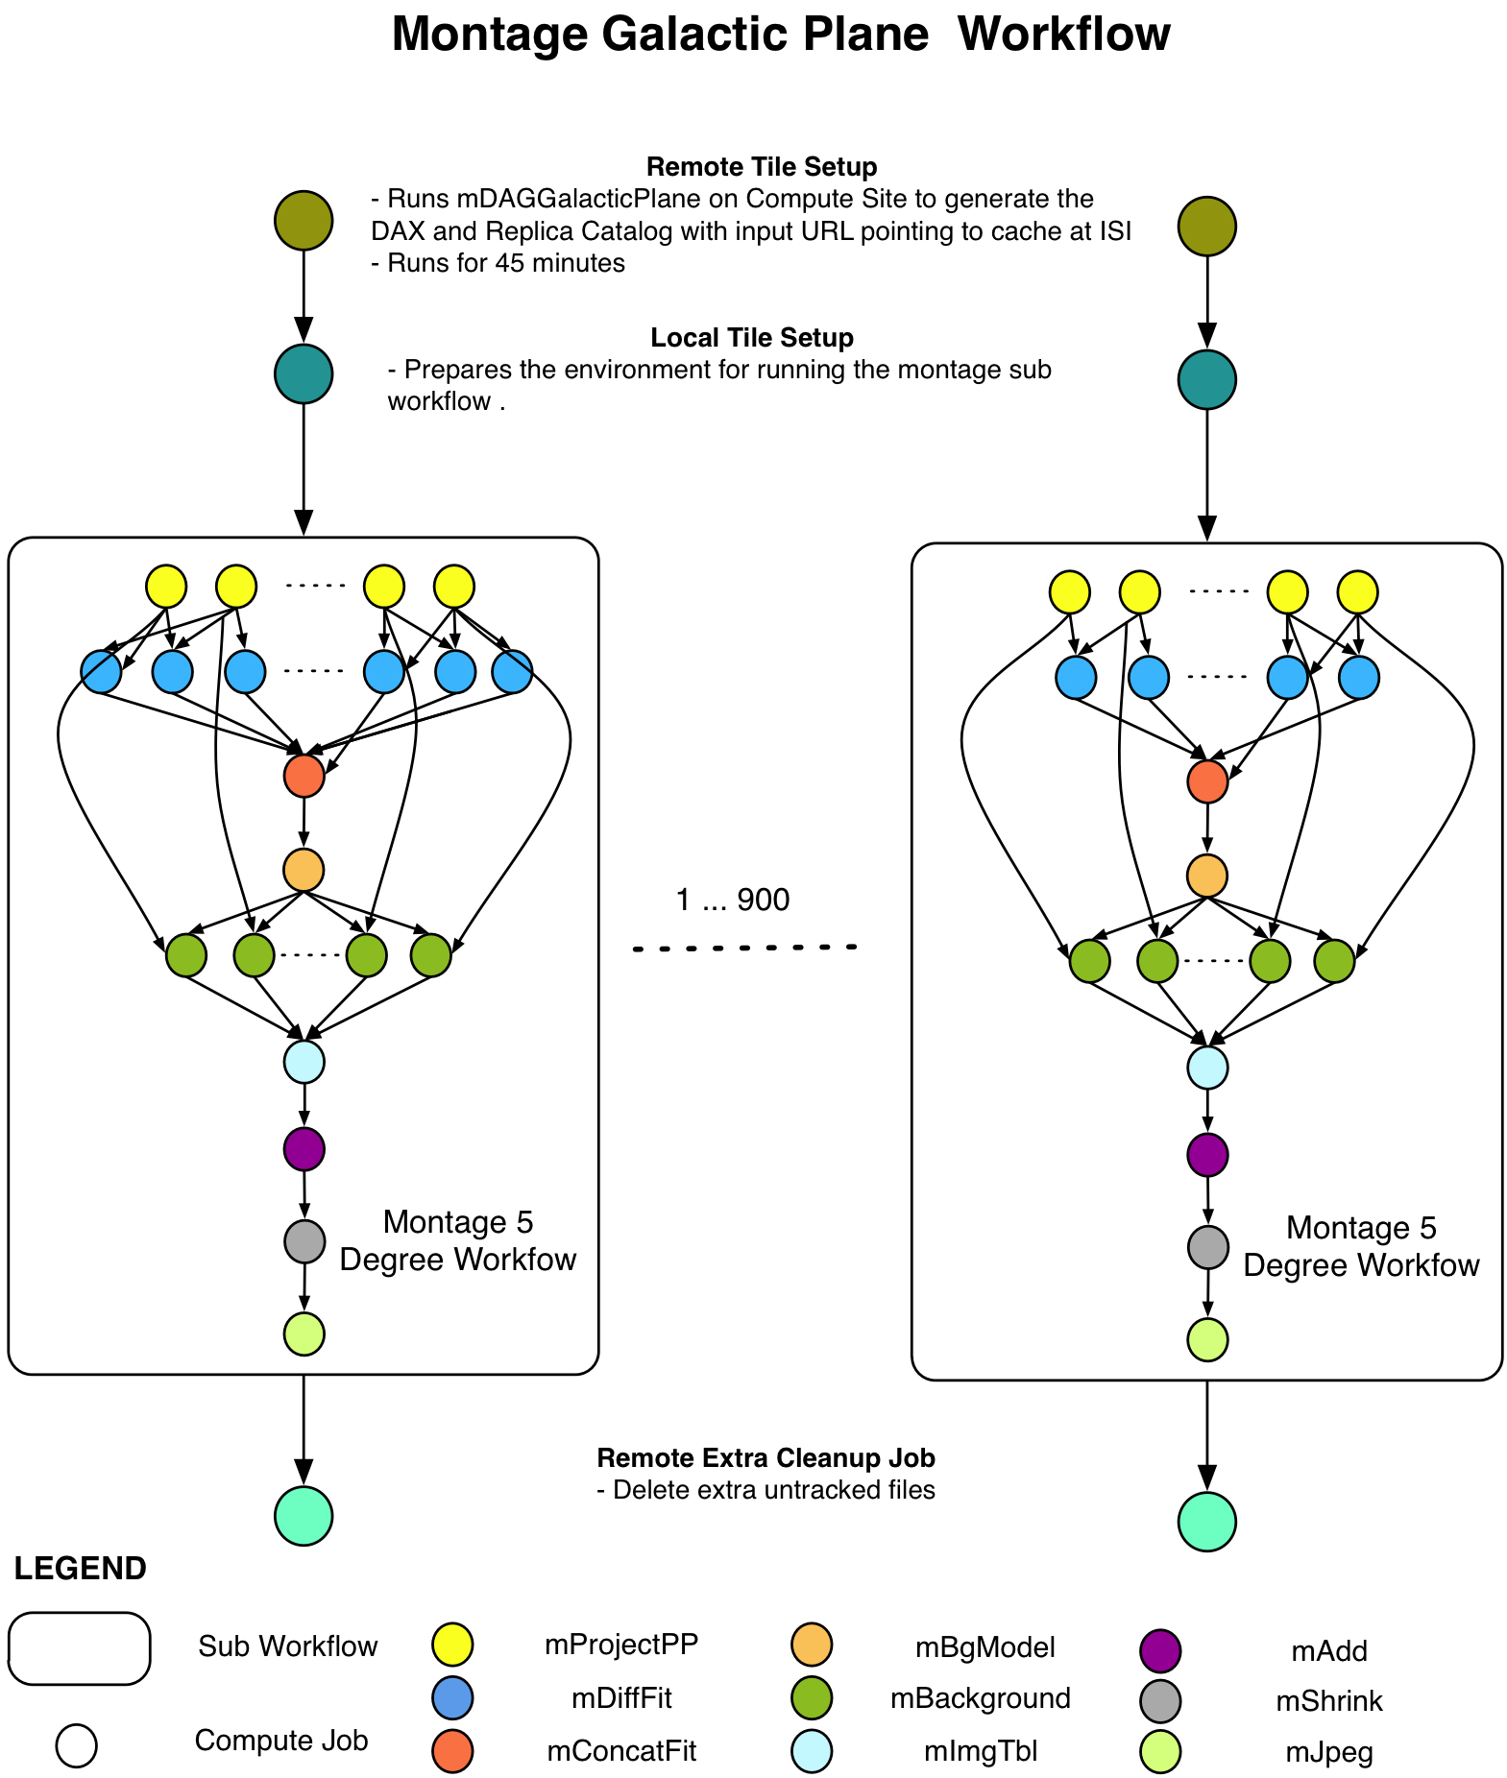
Connecting Pipelines
Solution
Pegasus allows jobs/nodes in a workflow to refer to other workflows, allowing users to connect distinct workflows for analysis.
Updated our debugging tools to handle these workflow of workflows.
Notes:
Kent changed 080501 – removed period

Slide 4
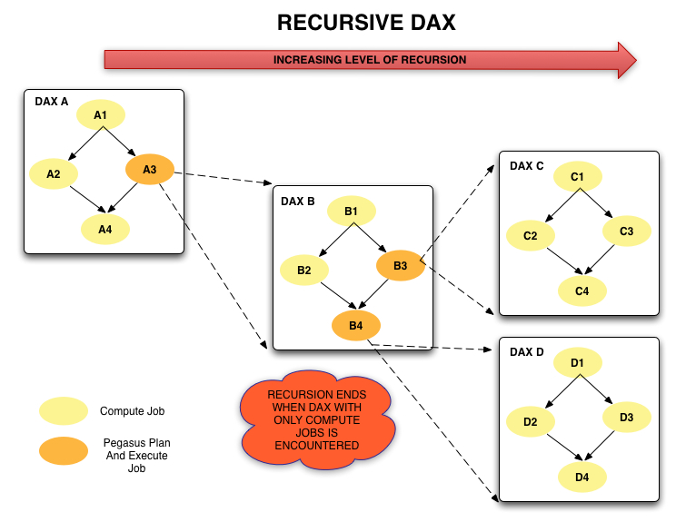
Hierarchical Workflows
Notes:
Kent changed 080430
Kent changed 080128-2 – added this slide
Talk about why

Slide 5
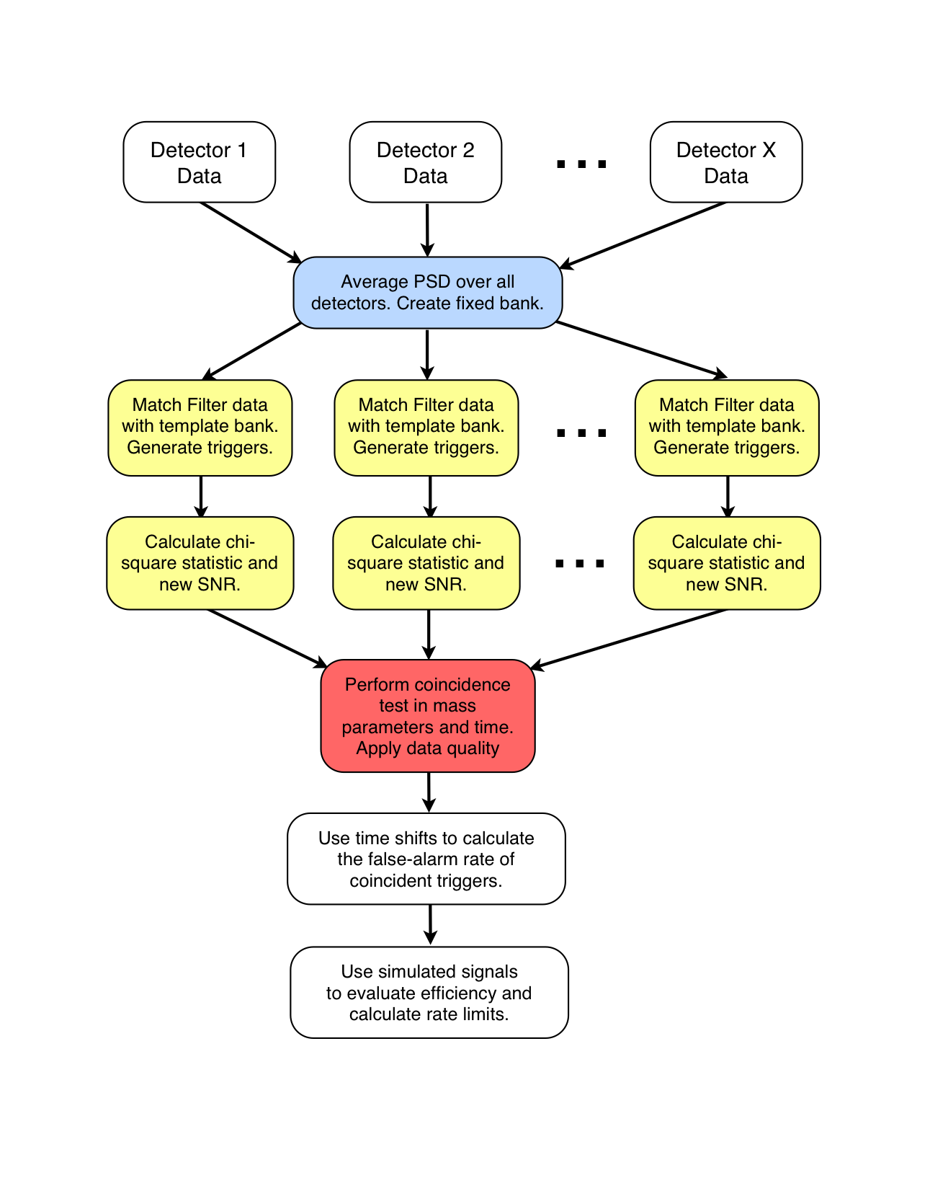
Reusing Data Products
Problem
Users want to be able to intelligently reuse previously generated outputs.
Genomic Workflows want to avoid index generation steps for raw input files
Long running analysis fail, and users realize they need to regenerate workflow description, as wrong arguments set or missing jobs.
Example Application
Advanced LIGO pyCBC pipeline
60,000 compute tasks
Input Data: 5000 files (10GB total)
Output Data: 60,000 files (60GB total)
Often user errors in setup that
lead to failures midway.
Notes:
Kent changed 080501 – removed period

Slide 6
Reusing Data Products
Solution: Workflow Reduction
Don’t execute jobs at runtime for which data products already exist.
Similar to make style semantics for compiling code
Notes:
Sometimes it is cheaper to access the data than to regenerate it
Keeping track of data as it is generated supports workflow-level checkpointing
Kent changed 080501 – added period

Slide 7
File cleanup
Problem
Users run out out of disk space during workflow execution
Why does it occur
Workflows could bring in huge amounts of data
Data is generated during workflow execution
Users don’t worry about cleaning up after they are done
Example Application
SoyKB workflows from iPlant
Epigenomics Pipelines generating 60TB of data in a single execution
Notes:
Kent changed 080501

Slide 8
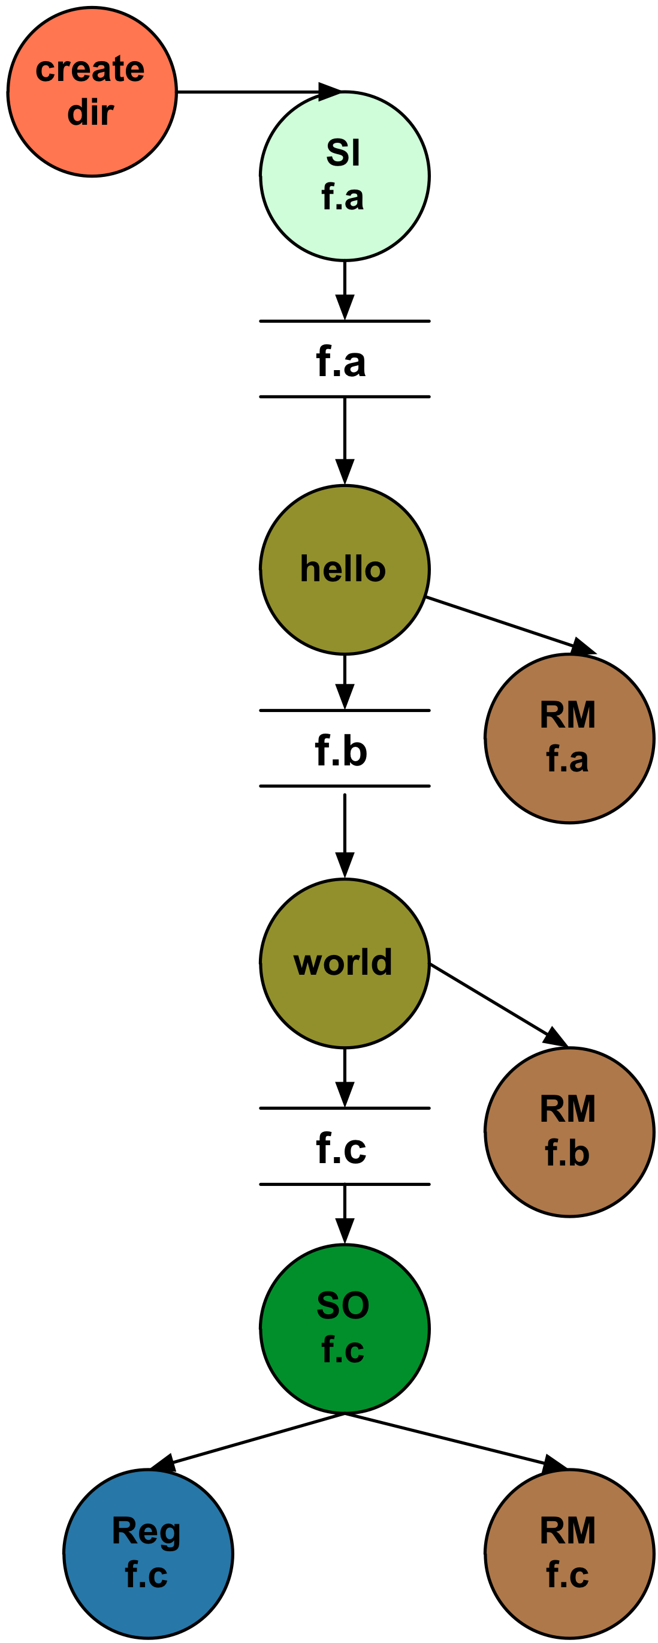
File cleanup
Solution
Do cleanup after workflows finish
Does not work as the scratch may get filled much before during execution
Interleave cleanup automatically during workflow execution.
Requires an analysis of the workflow to determine, when a file is no longer required
Cluster the cleanup jobs by level for large workflows
Too many cleanup jobs adversaly affect the walltime of the workflow.
Notes:
Kent changed 080501

Slide 9
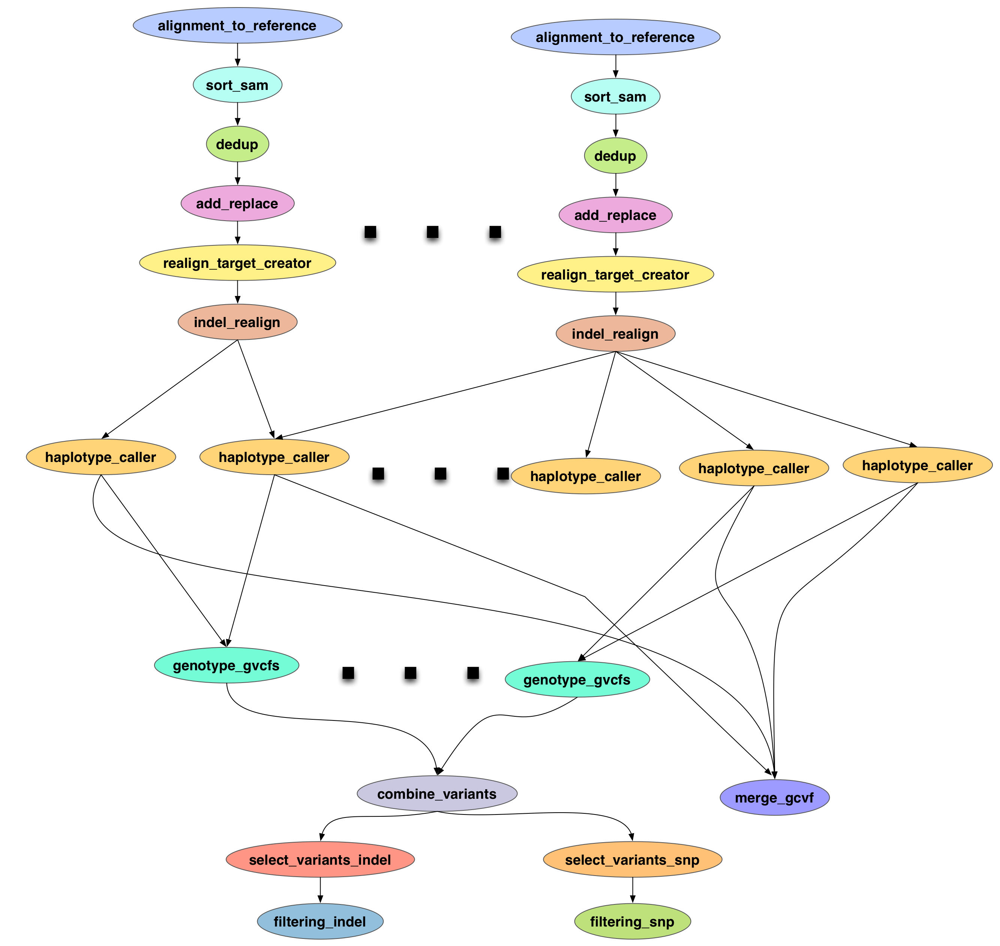
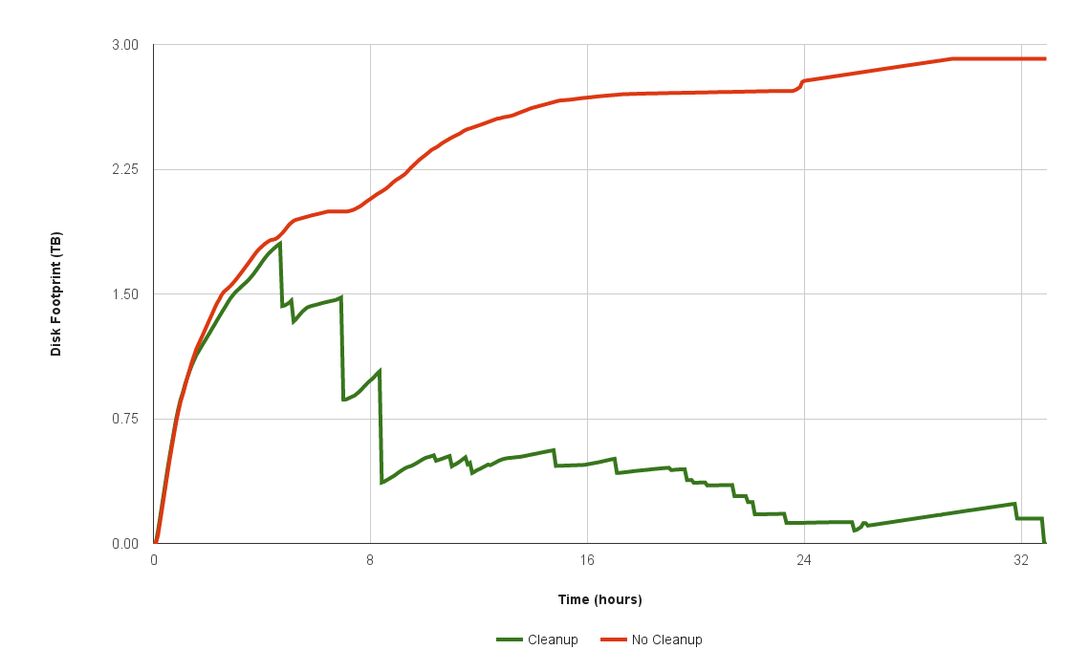
File cleanup (cont)
Single SoyKB NGS Pegasus
Workflow with 10 input reads.
Notes:
The attached graph shows two Pegasus runs for the SoyKB workflow with 10 input reads. A typical production workflow is about 4 times larger. One run is with inplace cleanup and one without cleanup
Without inplace cleanup
{
"data_config": "sharedfs",
"wf_metrics": {
"compute_tasks": 290,
"total_tasks": 290,
"dax_input_files": 23,
"dax_inter_files": 550,
"dax_output_files": 7,
"dax_total_files": 580,
"compute_jobs": 290,
"si_tx_jobs": 40,
"so_tx_jobs": 48,
"reg_jobs": 155,
"cleanup_jobs": 1,
"create_dir_jobs": 1,
"chmod_jobs": 18,
"total_jobs": 553
},
"app_metrics": {
"name": "Soykb"
}
}

Slide 10
Task Clustering
Cluster small running jobs together to achieve better performance
Why?
Each job has scheduling overhead – need to make this overhead worthwhile
Ideally users should run a jobs that take at least 10/30/60/? minutes
Clustered tasks can reuse common input data – less data transfers
Horizontal clustering
Label-based clustering
Also: time-based clustering

Slide 11
Fine-Grained Workflows
Problem: Many scientific workflows are fine-grained
Thousands of tasks
Short duration
Serial
Collectively, these tasks require distributed resources to finish in a reasonable time, but individually they are relatively small
Touch many GB or TB of data
Consume thousands of CPU hours
Many large-scale compute resources are optimized for a few, large, parallel jobs, not many small, serial jobs
Serial tasks face long queue times due to low priority
Batch schedulers have low throughput
Results in poor workflow performance

Slide 12
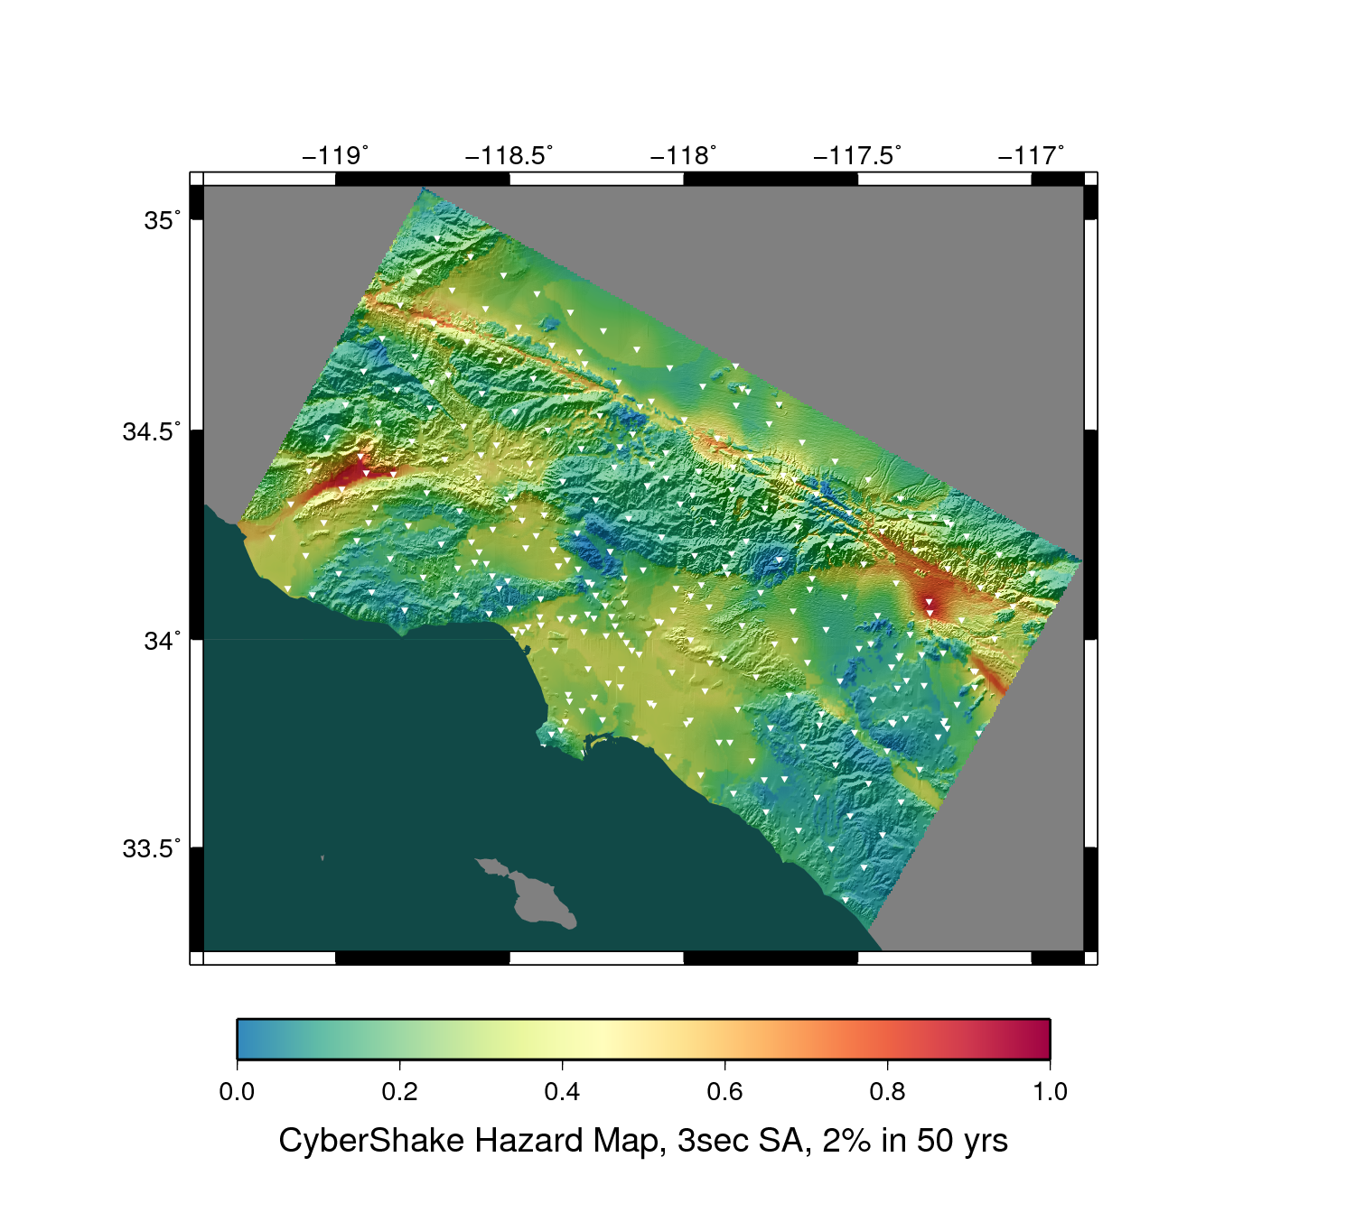
Fine Grained Workflows
CyberShake PSHA Workflow
Builders ask seismologists: “What will the peak ground motion be at my new building in the next 50 years?”
Seismologists answer this question using Probabilistic Seismic Hazard Analysis (PSHA)
2014: 286 Sites, 4 models
Each site = one workflow
Each workflow has 420,000 tasks in 21 jobs

Slide 13
Fine Grained Workflows
Solution: Pegasus-MPI-Cluster
A master/worker task scheduler for running fine-grained workflows on batch systems
Runs as an MPI job
Uses MPI to implement master/worker protocol
Works on most HPC systems
Requires: MPI, a shared file system, and fork()
Allows sub-graphs of a Pegasus workflow to be submitted as monolithic jobs to remote resources
Master
(rank 0)
Worker
(rank 1-N)

Slide 14
PMC Features
Fault Tolerance
Retries at the task level (master resends task to another worker)
Retries at the workflow level (using a transaction log to record progress)
Resource-aware scheduling
Many HPC machines have low memory/core
PMC can allocate memory and cores to a task, and force other slots on the same node to be idle
I/O Forwarding
Small tasks == small I/O == poor performance
PMC reads data off of pipes from worker and forwards it using MPI messages to a central I/O process, which collects the data and writes it to disk
Writes are not interleaved, no locking required for synchronization

Slide 15
What Does Pegasus provide an Application - I
Portability / Reuse
User created workflows can easily be mapped to and run in different environments without alteration.
Data Management
Pegasus handles replica selection, data transfers and output registrations in data catalogs. These tasks are added to a workflow as auxiliary jobs by the Pegasus planner.
Performance
The Pegasus mapper can reorder, group, and prioritize tasks in order to increase the overall workflow performance.
Notes:
Kent changed 080501 – removed period

Slide 16
What Does Pegasus provide an Application - II
Provenance
Provenance data is collected in a database, and the data can be summaries with tools such as pegasus-statistics, pegasus-plots, or directly with SQL queries.
Reliability and Debugging Tools
Jobs and data transfers are automatically retried in case of failures. Debugging tools such as pegasus-analyzer helps the user to debug the workflow in case of non-recoverable failures.
Scalability
Hierarchal workflows
Scale to hundreds of thousands of nodes in a workflow.
Notes:
Kent changed 080501 – removed period

Slide 17
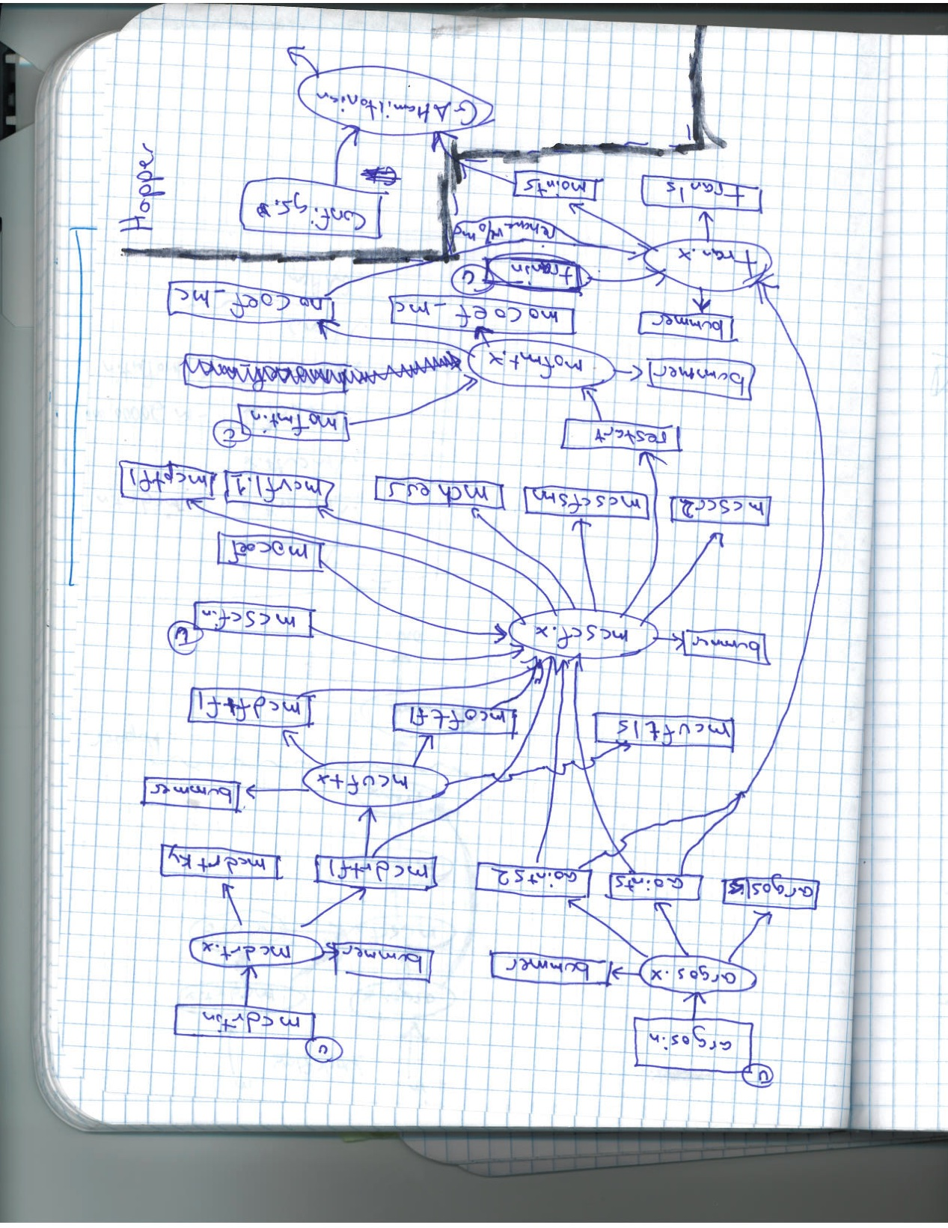
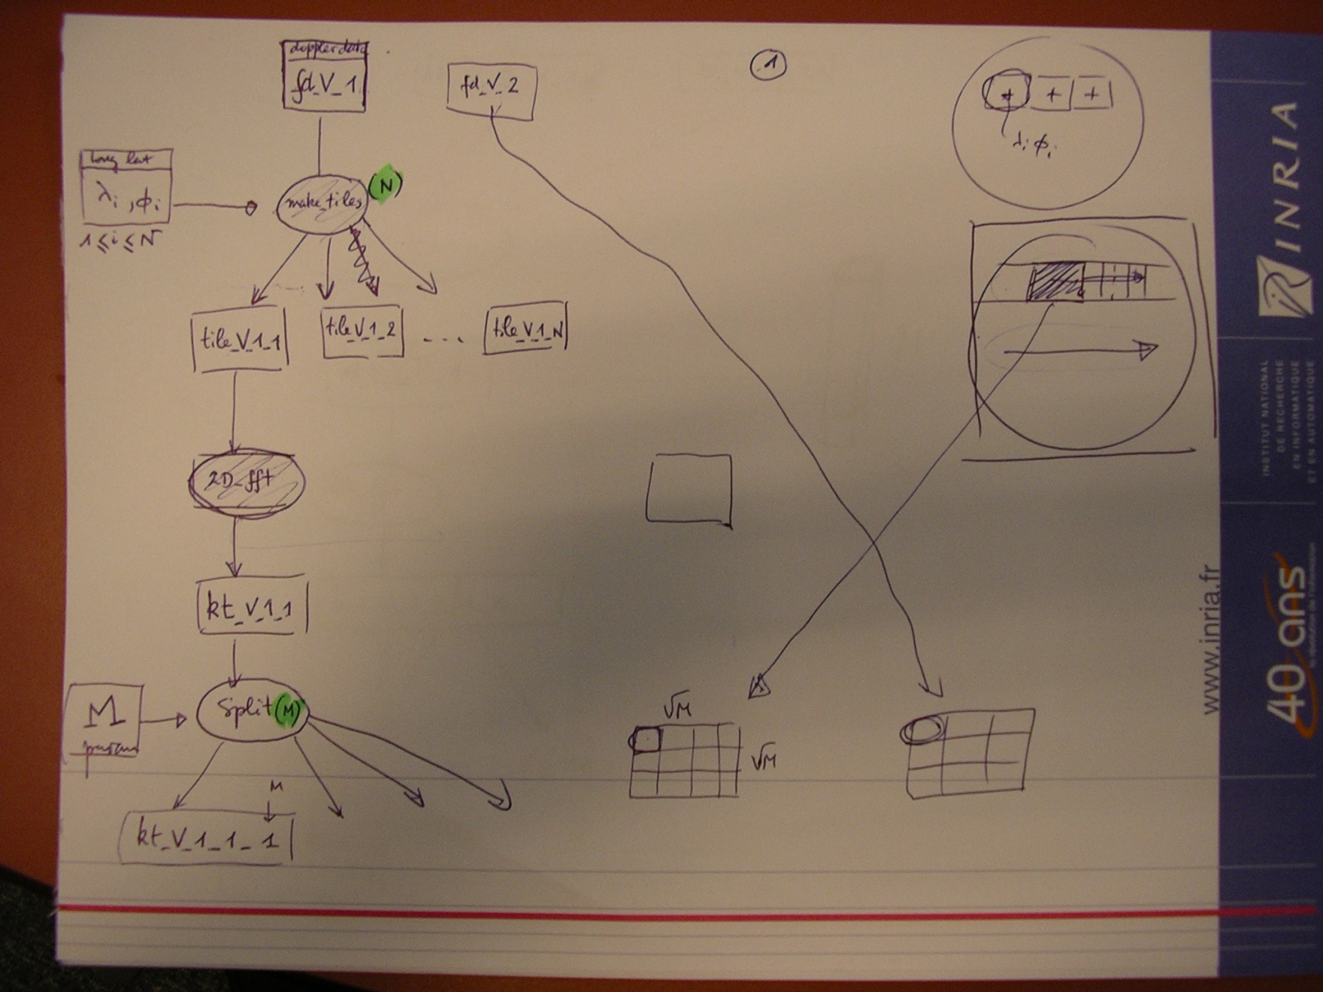
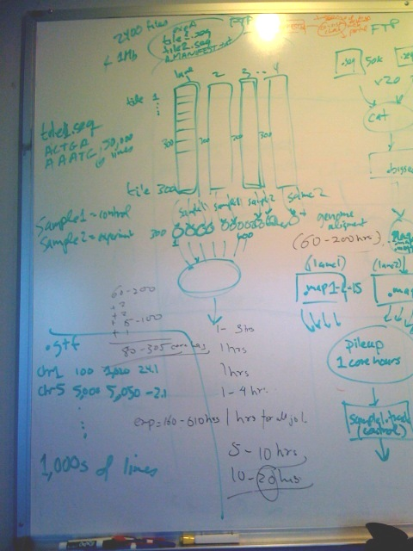
If you get stuck…
And you can draw….
We can help you!
Support: pegasus-support@isi.edu
pegasus-users@isi.edu

Slide 18
Relevant Links
Pegasus: http://pegasus.isi.edu
Tutorial and documentation: http://pegasus.isi.edu/wms/docs/latest/
Support: pegasus-users@isi.edu pegasus-support@isi.edu
HipChat Support Room
Acknowledgements
Pegasus Team, Condor Team, funding agencies, NSF, NIH, and everybody who uses Pegasus.

